Slide 1
ANALYSTLAB AFRICA · HEALTHCONNECT EXPERIENCE LAB · WEEK 8
Data Analytics
Final Findings & Decision Support
Why HealthConnect Clinic loses over half its appointment capacity to no-shows — and what to do about it.
Oluwatosin Olusanya · Data Analyst, Data Analytics Track
HC-POD Final Integration

Slide 2
The problem, in one number
51.2%
of scheduled appointments end in a no-show — 2,423 of 4,737 definitive-outcome appointments.
Confirmed, independently re-validated, and statistically tested across 8 weeks of analysis. Two factors drive it overwhelmingly: booking lead time and a patient's own no-show history.
HealthConnect Final Analytics & Decision Support Package · Week 8
Notes:
This is a structural problem, not a seasonal one — the rate has held steady across the full analysis period.

Slide 3
Final validated KPIs
KPI | Final value | Notes
Overall no-show rate | 51.2% | 2,423 of 4,737 appointments; reproduced exactly in Week 7
No-show rate by lead time | 26.6% → 63.9% | 0-3 days vs 30+ days booked ahead; χ²=340.42, p<0.001
Repeat no-show rate | 46.3% → 70.3% | 0 vs 3+ prior no-shows; χ²=72.36, p<0.001
Reminder effectiveness | 0.4 – 6.5 pt | Improvement varies by risk segment; largest for at-risk patients
Combined risk segmentation | 28.0% → 63.6% | Lowest-risk (715 appts) vs highest-risk (1,529 appts) segment

Slide 4
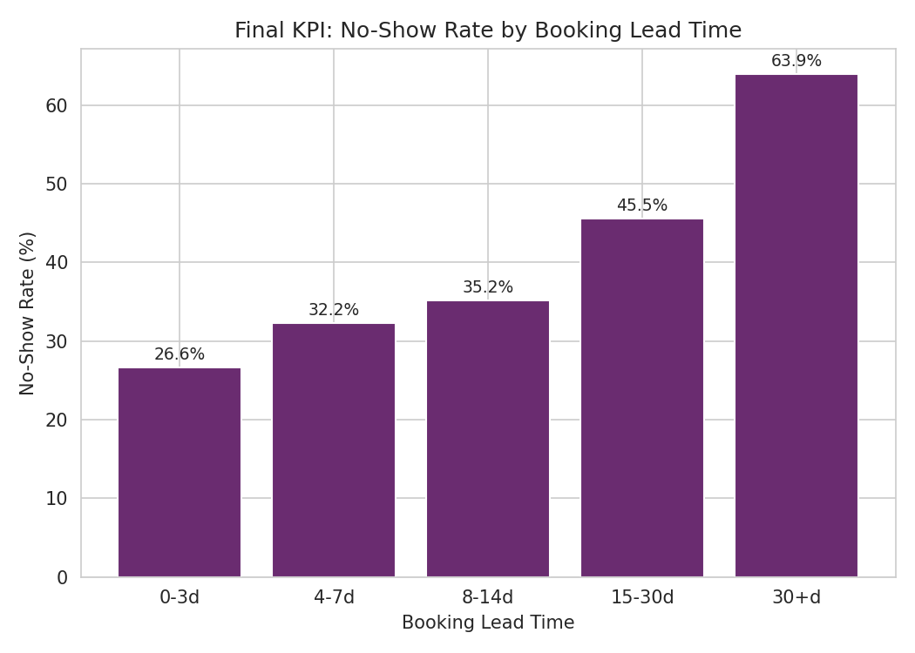
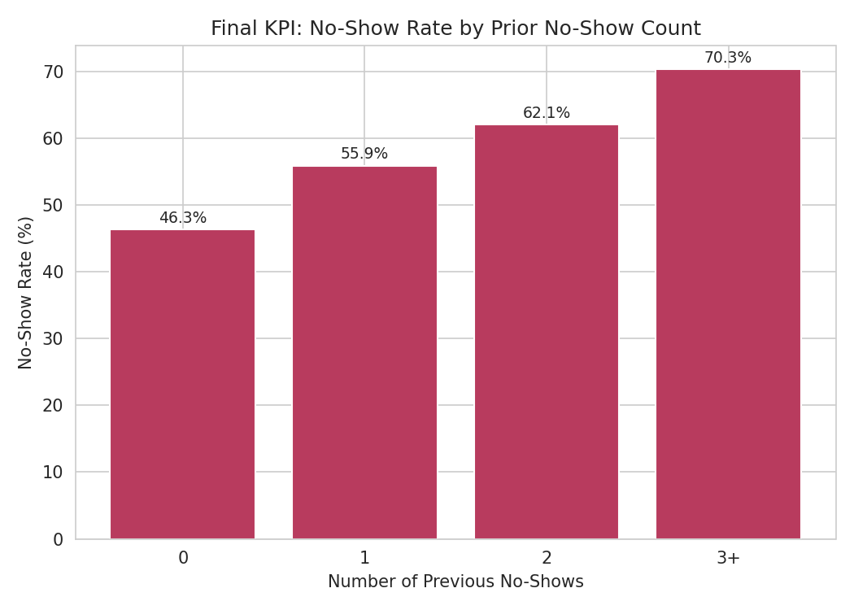
The two strongest drivers
Booking lead time — the strongest individual driver (χ²=340.42, p<0.001)
Prior no-show count — the second-strongest driver (χ²=72.36, p<0.001)
The two factors combine additively, not synergistically (interaction p=0.50) — each can be addressed independently.

Slide 5
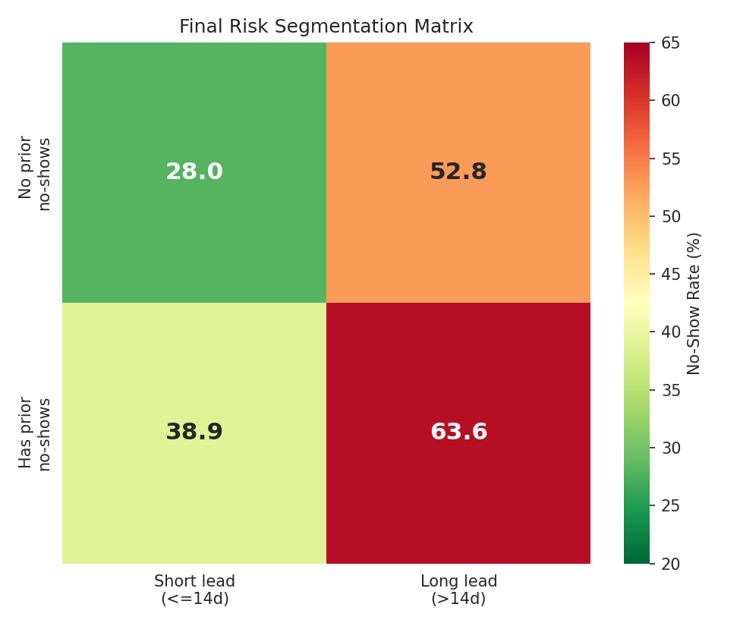
One targetable group
Combining lead time and prior no-show history isolates a clear highest-risk segment:
63.6%
no-show rate — 1,529 appointments, 1,035 patients
vs. 28.0% in the lowest-risk segment (715 appointments)

Slide 6
From patterns to action
Business insights
Recommendations
Roughly 1 in 2 appointments is missed — a structural problem, not a seasonal one
1,529 appointments (1,035 patients) carry a disproportionate share of risk and are directly targetable
Reminders help modestly, but least where risk is already low — not a standalone fix
Under-25 and over-65 patients need a different intervention; lead time matters less for them
Route the 1,529-appointment highest-risk segment to confirmation calls or double-booking
Shorten the default booking window, or require re-confirmation past 14 days out
Design distinct outreach for under-25 and over-65 patients
Keep SMS reminders as a baseline, prioritized by channel performance
Adopt this risk-segmentation approach as a standing quarterly review

Slide 7
Limitations & where this feeds next
Limitations
Cross-track contribution
Descriptive/associational — doesn't by itself prove causality on lead time
Small missing data in distance and waiting-time fields, excluded row-wise
No interactive BI dashboard built; outputs are static, reproducible charts
Age-band findings directionally clear but based on moderate sample sizes
Data Science: lead time & prior no-shows confirmed as top predictive features, plus a candidate risk-segment flag
Project Management: the 1,529-appointment segment sized for staffing and confirmation-call planning
Every finding here was independently re-derived, statistically tested, and stress-tested — portfolio-ready, not first-pass.
Notes:
Closing note: this analysis moved the project from an abstract "target high-risk patients" goal to a sized, evidence-backed segment PM can plan around.

